Slide 1
Final Project -Titanic
Yingjun Pan

Slide 2
Introduction
the Titanic sank after colliding with an iceberg and killing 1502 out of 2224 passengers and crew.
There were about 1300 passengers and the rest people are crew.
The purpose of this project is to analysis of what sorts of people were likely to survive.
Dataset from kaggle.com and total 1309 oberzavations

Slide 3
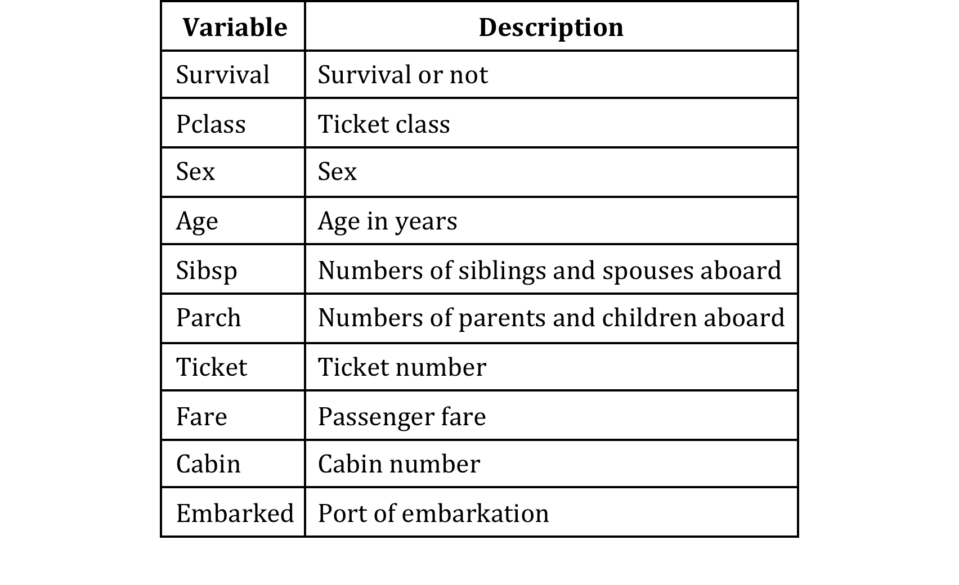
Description of Variables

Slide 4
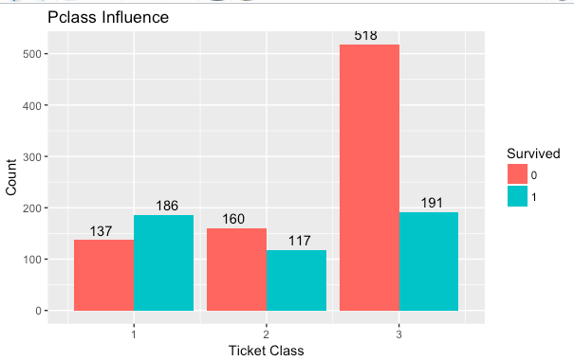
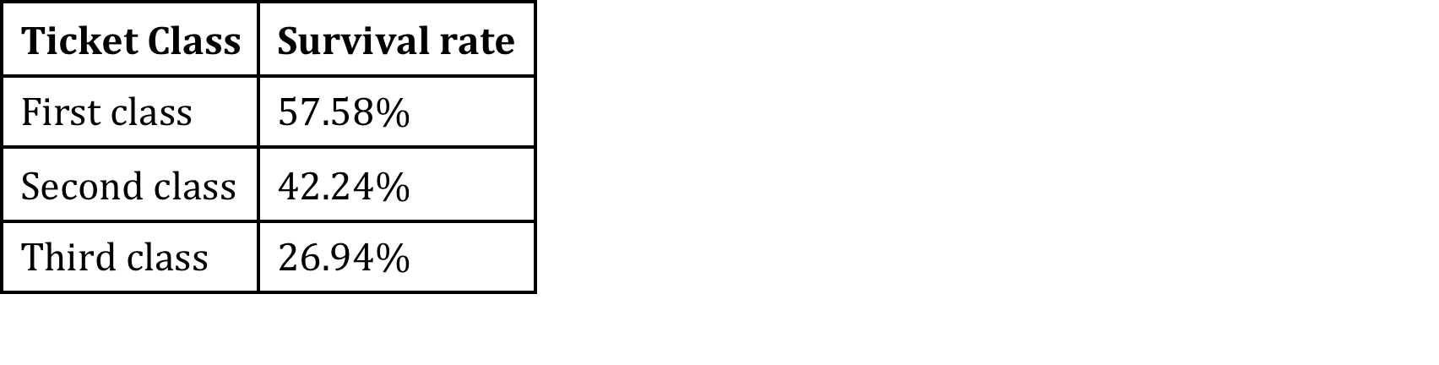
Exploring Data - Pclass
Majority:
third class
highest survival rate:
first class

Slide 5
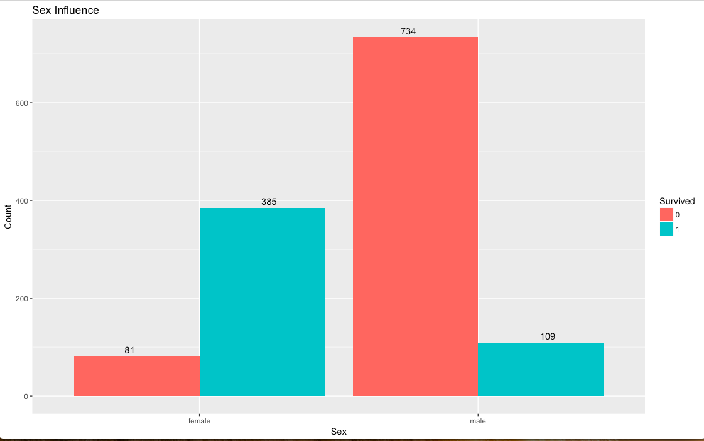
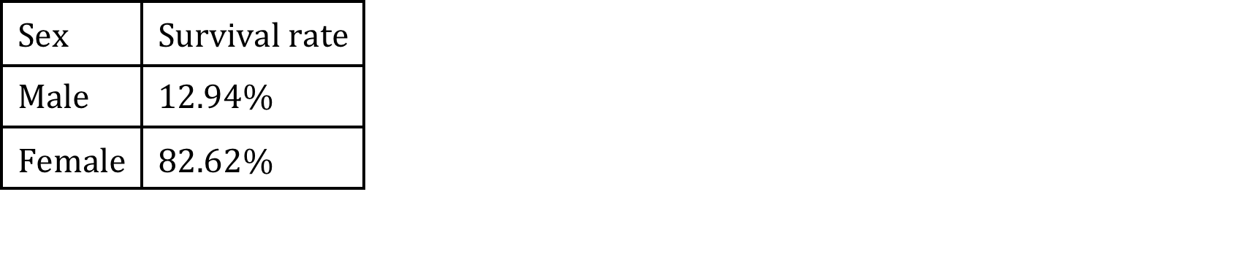
Exploring Data - Sex
Majority:
Male
Highest Survival Rate:
Female

Slide 6
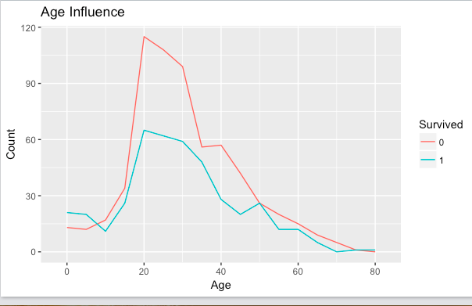
Exploring Data - Age
Majority:
16 to 40 years old

Slide 7
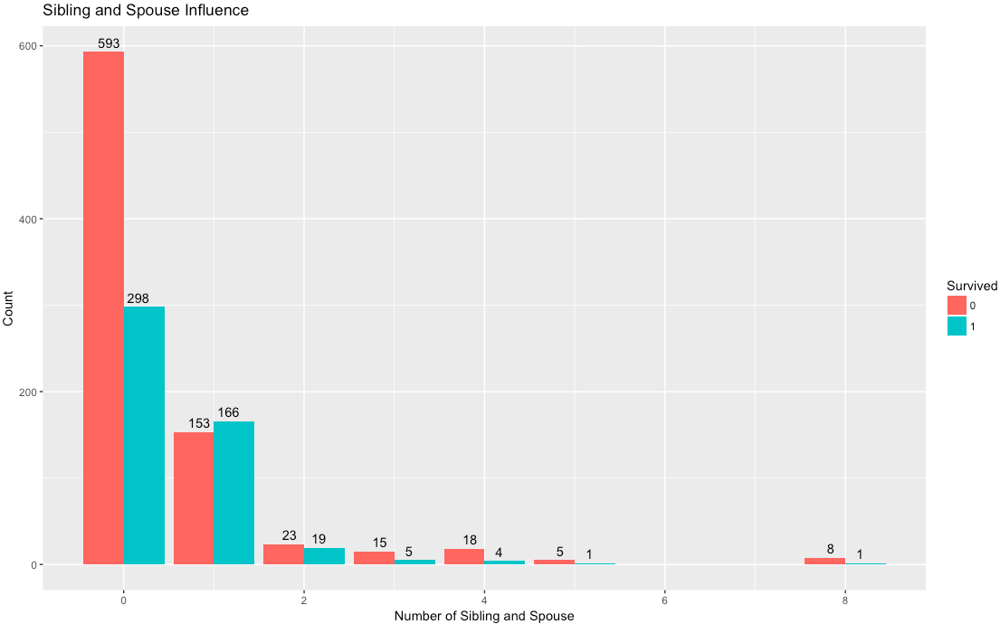
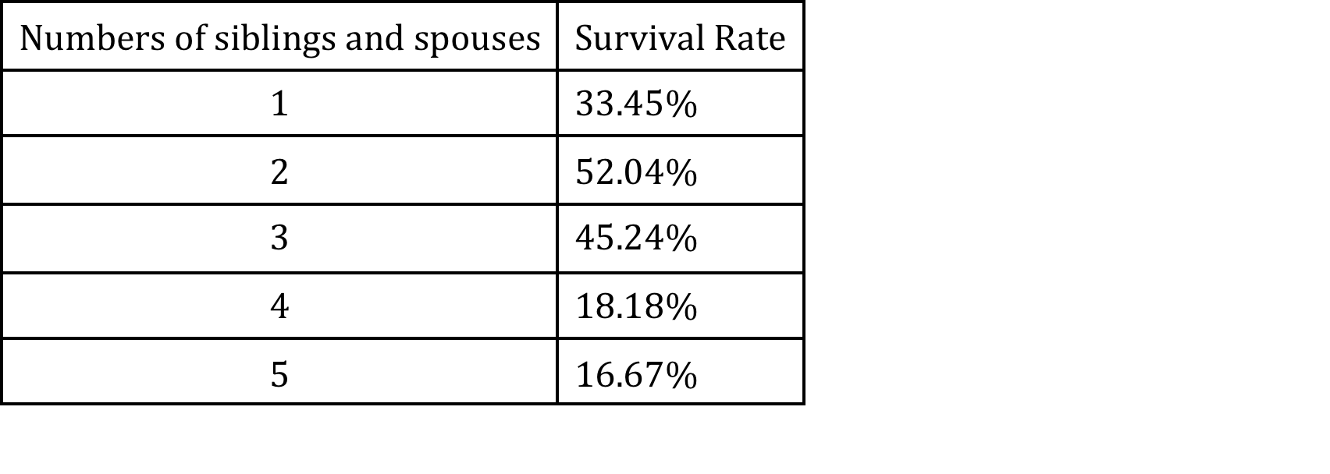
Exploring Data - Sibsp
Majority:
Aboard with 0 Sib/Sp
Highest Survival Rate:
Aboard with 3 Sib/Sp

Slide 8
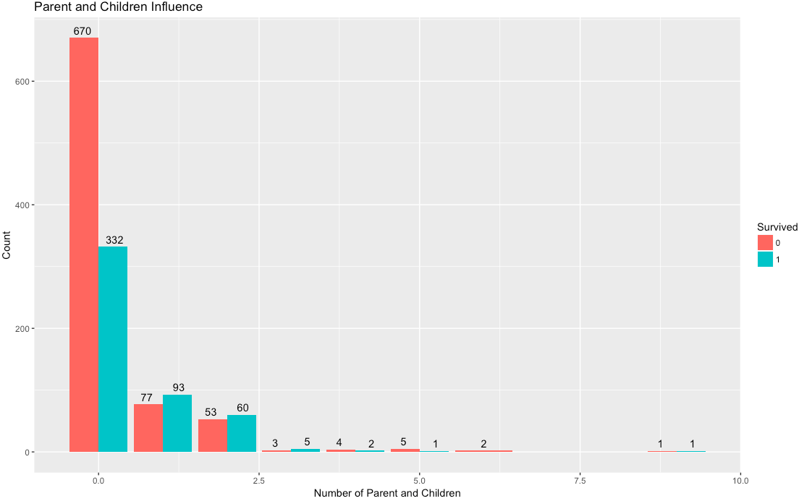
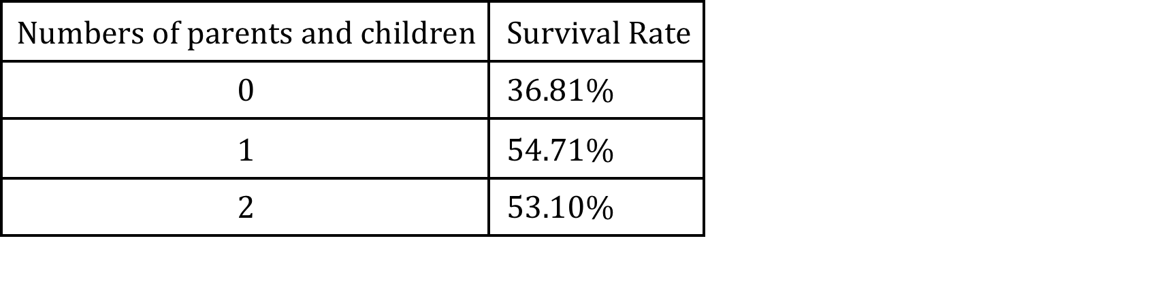
Exploring Data - Parch
Majority:
Aboard with 0 Par/Ch
Highest Survival Rate:
Aboard with 1 Par/Ch

Slide 9
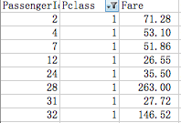
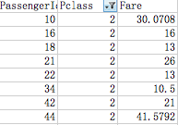
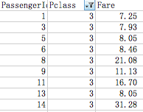
Exploring Data - Fare
Fare has not direct relationship with ticket class.
The fare between 20 and 30 occurred in all of 3 ticket classes

Slide 10
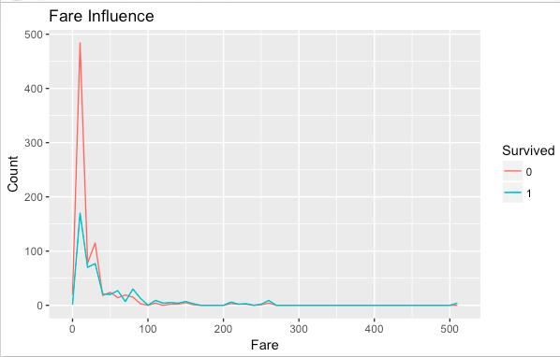
Exploring Data - Fare
Majority:
Between 5 and 50

Slide 11
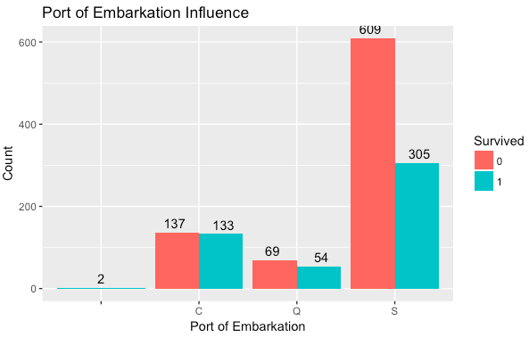
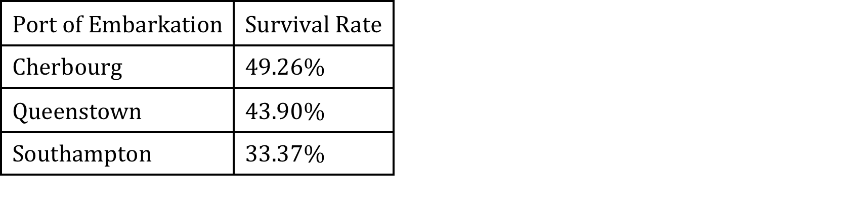
Exploring Data - Embarked
Majority:
Southampton
highest survival rate:
Cherbourg

Slide 12
Missing Value
Variable | # of Missing
Age | 263
Fare | 1
Cabin | 1014
Embarked | 2
How to fill missing data:
Age: using Mice method
Fare: using mean from passengers who in 3rd Pclass and S embarked
Cabin: did nothing. Too much missing value (77.5%) to be fill accurately
Embarked: most common value

Slide 13
New variable - Title
Title | Composition
Master | Master
Miss | Lady, Mlle., Ms., Miss
Mrs. | Mme., Mrs.
Mr. | Mr.
Rare Title | others
The title comes from name variable.
Select titles shown many times and combine others into them

Slide 14
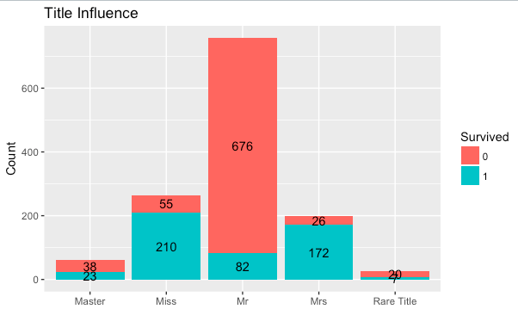
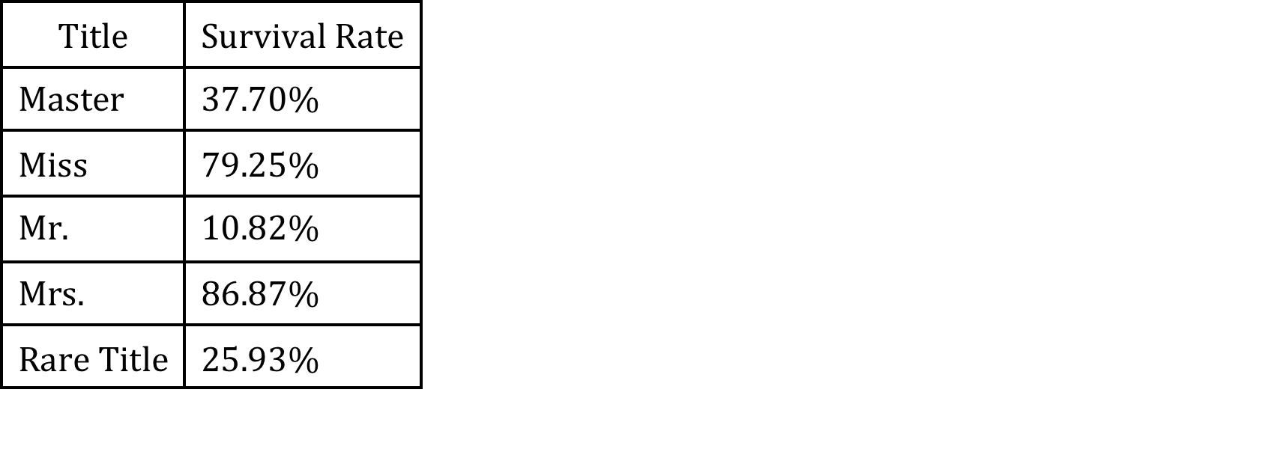
Exploring Data - Title
Majority:
Mr.
highest survival rate:
Mrs.

Slide 15
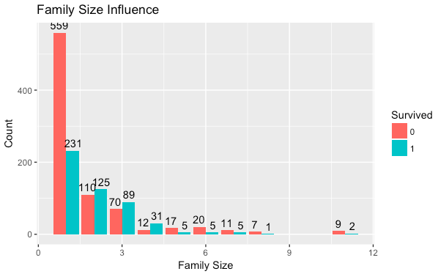
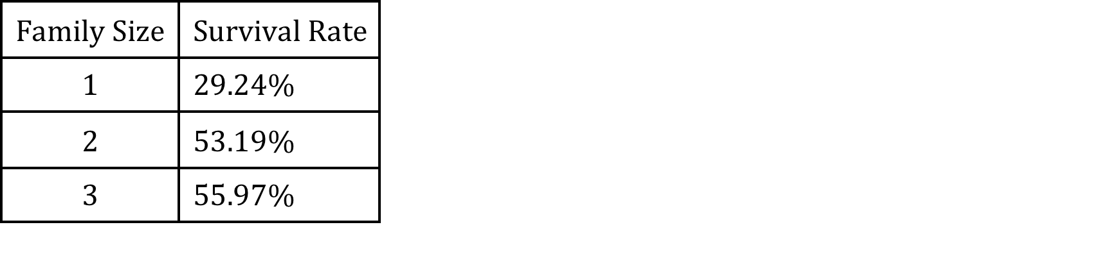
New variable – Family Size
Fsize = SibSp + Parch + 1
Majority:
With 1 family member
highest survival rate:
With 3 family member

Slide 16
New variable – Ticket Count
The ticket count comes from ticket variable.
Passengers with a same ticket number - they know other people, so they were not aboard alone
Passengers with unique ticket number they aboard alone

Slide 17
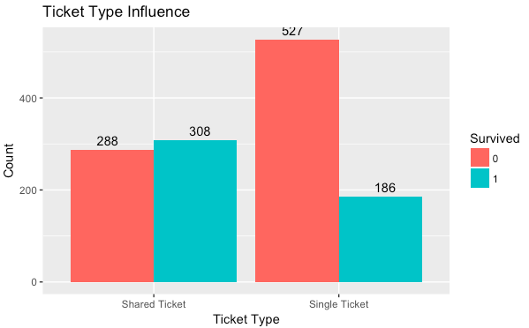
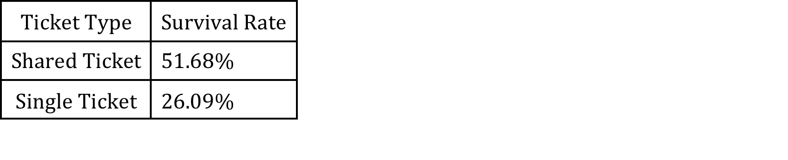
Exploring Data – Ticket Count
Majority:
Single Ticket
highest survival rate:
Shared Ticket

Slide 18
New variable – Age Group
Age Group | Requirement
Child | < 18
Middle Age | >= 18 and <= 50
old | >50
The age group comes from age variable.
Classify passengers based on age.

Slide 19
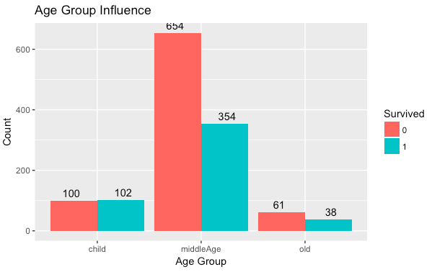
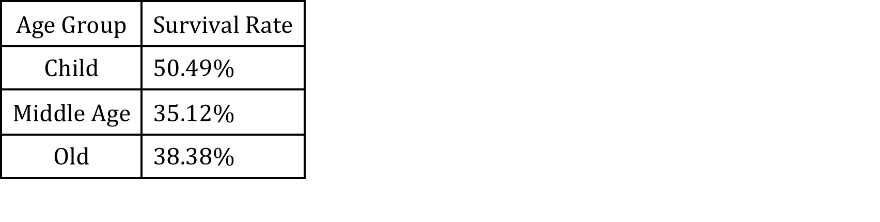
Exploring Data – Age Group
Majority:
Middle Age
highest survival rate:
Child

Slide 20
Methods
80% data are train data, rest are test data
Dependent Variable: Survival
Independent Variable: Ticket Class, Title, Sex, Age, # of Sibling and Spouses, # of Parent and Children, Family Size, Ticket Count, Fare, Embarked, Age Group
Methods: Random Forest, Decision Tree, Logistics Regression and SVM

Slide 21
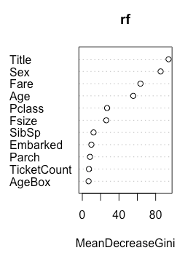
Random Forest and Refine
The importance of Ticket Count, Age Group, # of Parent and Children, Embarked and # of Sibling and Spouses are less than 20%.
The above variable are not used in the refine random Forest prediction.

Slide 22
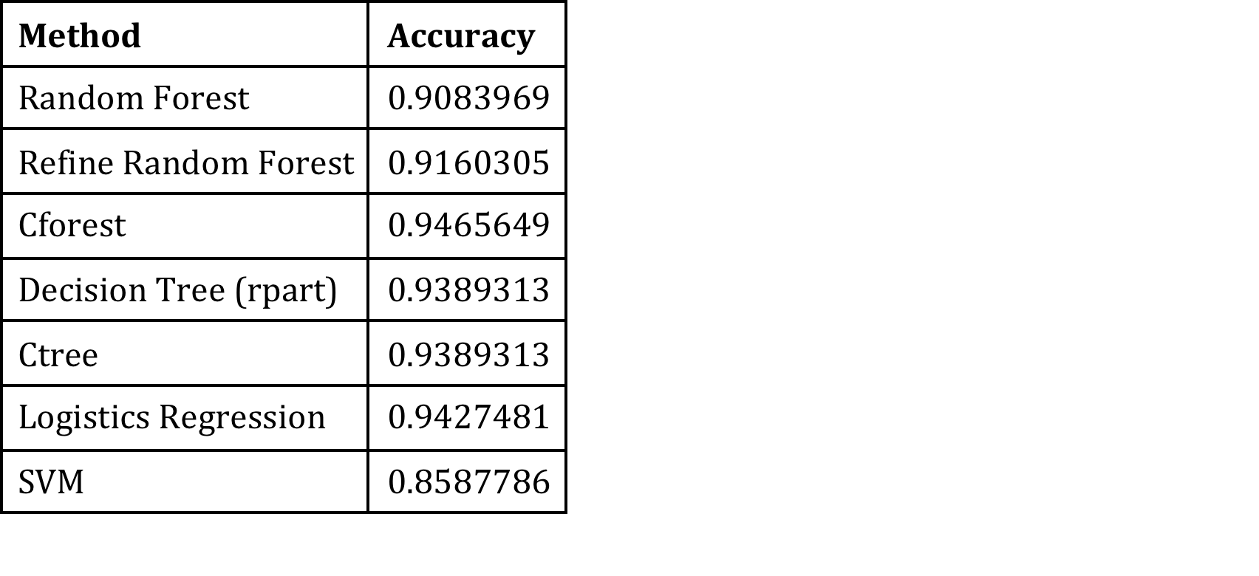
Results of Methods
Method rank based on accuracy:
Cforest > Logistics Regression > Decision Tree(rpart = ctree) > Refine Random Forest > Random Forest > SVM

